Slide 1
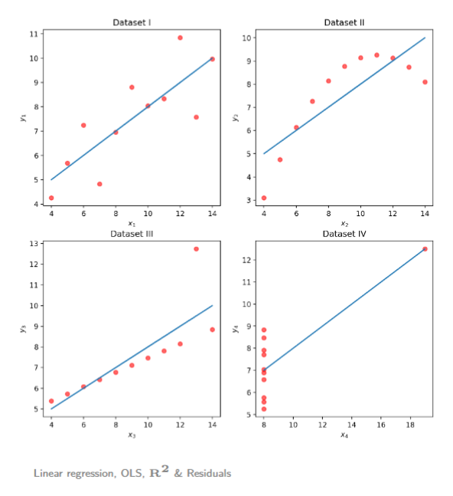
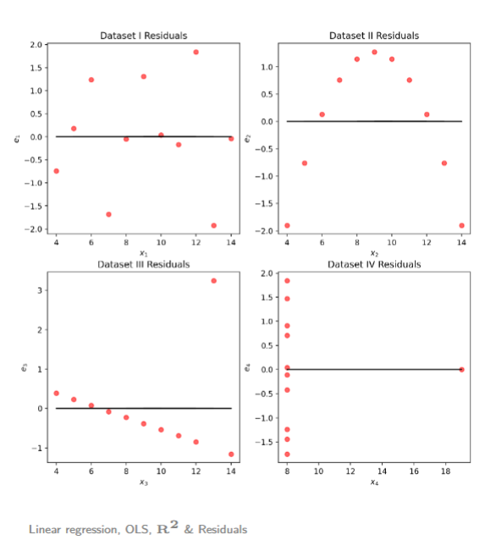

Slide 2
Controlled error handling
AI is powerful but it can’t always find the answer
In those instances you have to try different things to try to fix the error
One methodology that is particular is to look at instance or example where the action you’re performing works and see what’s the difference with what you’re doing now

Slide 3
Controlled error handling
Maybe the issue is in the file that we are reading!!

Slide 4
Controlled error handling
What’s wrong with the file we’re trying to read compared to the one we read before???

Slide 5
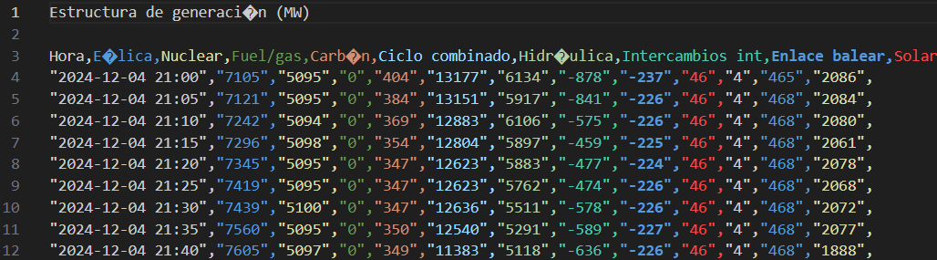
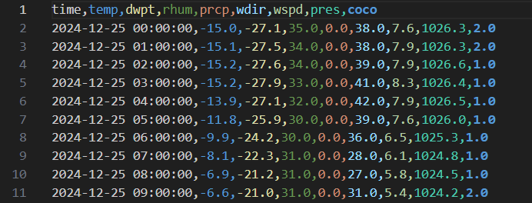
Controlled error handling
What’s wrong with the file we’re trying to read compared to the one we read before???

Slide 6
Controlled error handling
What’s wrong with the file we’re trying to read compared to the one we read before???

Slide 7
Controlled error handling

Slide 8
Manipulating files in your directory with python
Right now, we can read the files we downloaded
But we have a lot of files (a lot!!) in our folder
Going through them one by one would take wayyy too much time
To manipulate all these files, we will use a new library
os

Slide 9
OS
We have a lot of files that we want to work with
Going through them one by one would take wayyy too much time
os library allows us to manipulate the files in our directory
import os

Slide 10

OS
We’re gonna use this library to change the name of the files of interest in our directory
Get the directory we are working on at the moment
Get all the files in the directory

Slide 11
Pseudocode
Get a list of all the files in the directory (remember os)
Loop over all the filenames in the list
If the file is one of the files we want
Read the file and save it into a data frame, (remember the errors)
Append the data frame into a list
Total_csv = pd.concact(list_of_data_frame)

Slide 12
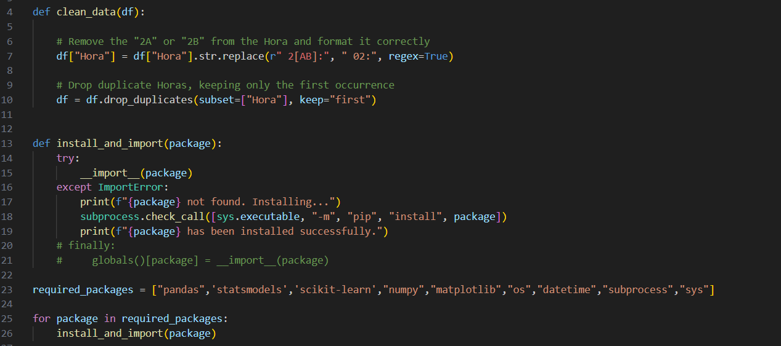

Slide 13
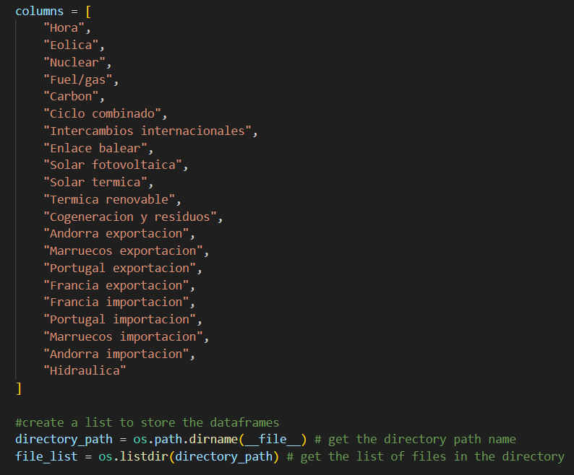

Slide 14
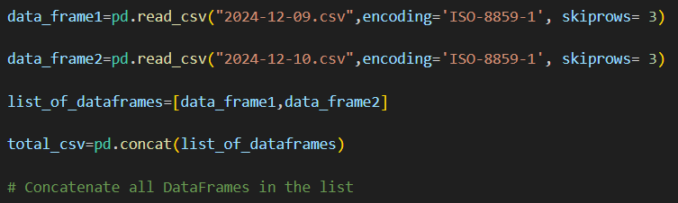
Concatonating
Now that we can successfully read the files we downloaded with error we’ll perform a small exercise
I’d like to combine all the files we downloaded into 1 large csv file
We can combine multiple csv files as follows

